Slide 1
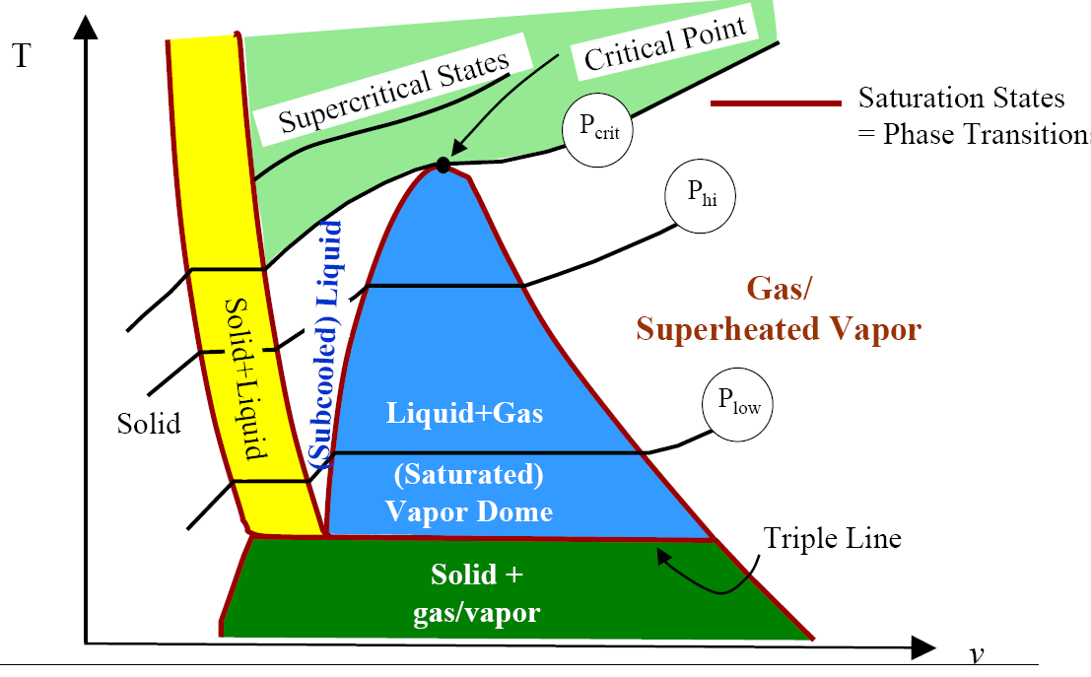
PROPERTIES OF PURE SUBSTANCES
IIT MANDI-175001
RAHUL VAISH

Slide 2
Objectives
Introduce the concept of a pure substance.
Discuss the physics of phase-change processes.
Illustrate the P-v, T-v, and P-T property diagrams and P-v-T surfaces of pure substances.
Demonstrate the procedures for determining thermodynamic properties of pure substances from tables of property data.
Describe the hypothetical substance “ideal gas” and the ideal-gas equation of state.
Apply the ideal-gas equation of state in the solution of typical problems.
Introduce the compressibility factor, which accounts for the deviation of real gases from ideal-gas behavior.
Present some of the best-known equations of state.

Slide 3
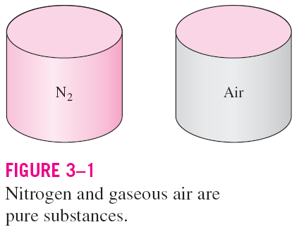
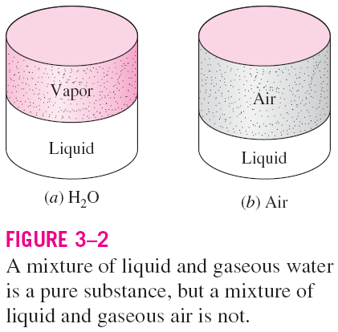
PURE SUBSTANCE
Pure substance: A substance that has a fixed chemical composition throughout.
Air is a mixture of several gases, but it is considered to be a pure substance.

Slide 4
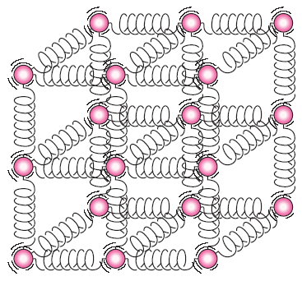
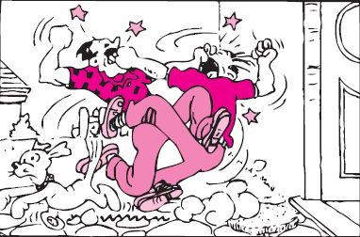
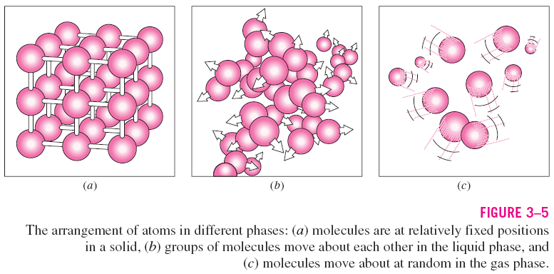
PHASES OF A PURE SUBSTANCE
The molecules in a solid are kept at their positions by the large springlike inter-molecular forces.
In a solid, the attractive and repulsive forces between the molecules tend to maintain them at relatively constant distances from each other.

Slide 5
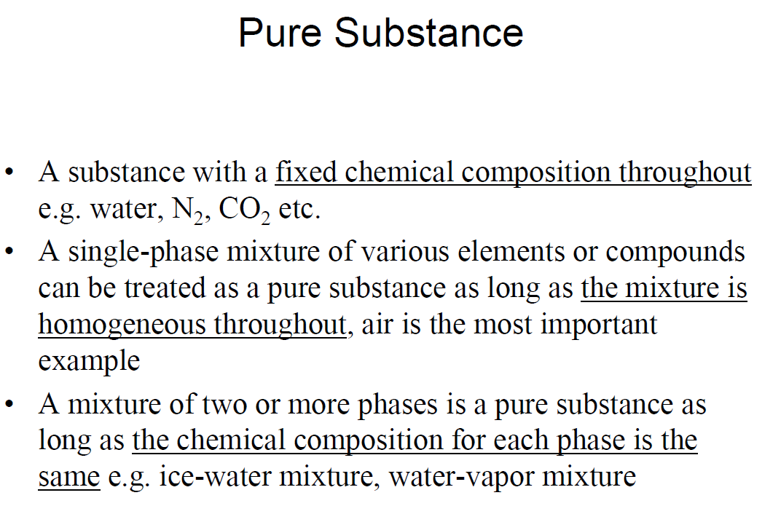

Slide 6
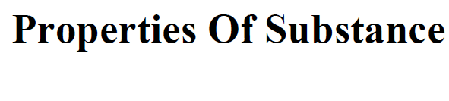
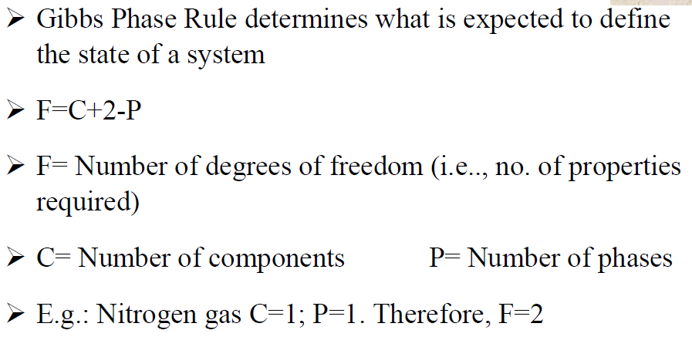

Slide 7
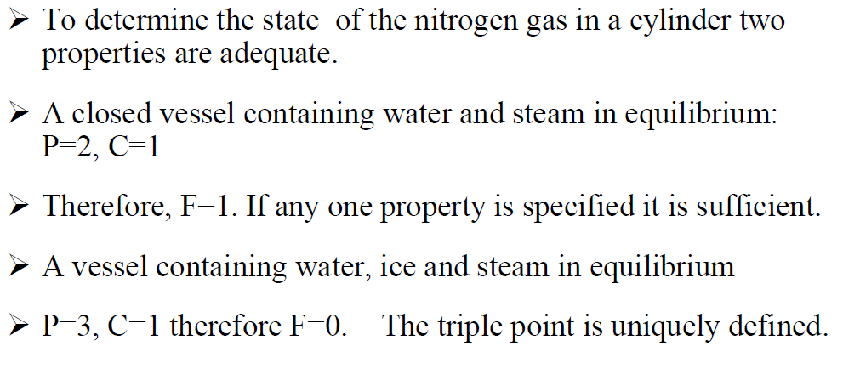

Slide 8
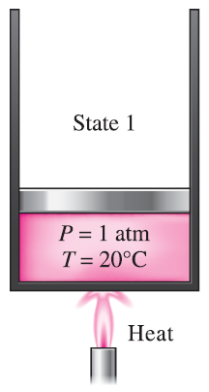
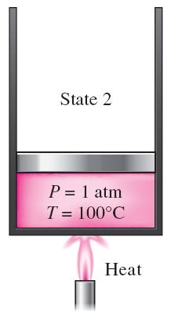
PHASE-CHANGE PROCESSES OF PURE SUBSTANCES
Compressed liquid (subcooled liquid): A substance that it is not about to vaporize.
Saturated liquid: A liquid that is about to vaporize.
At 1 atm and 20°C, water exists in the liquid phase (compressed liquid).
At 1 atm pressure and 100°C, water exists as a liquid that is ready to vaporize (saturated liquid).

Slide 9
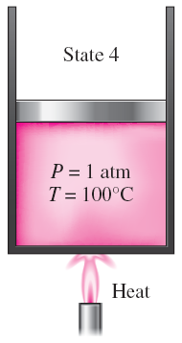
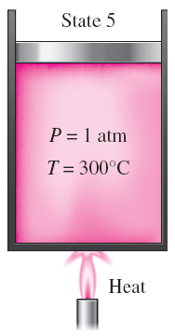
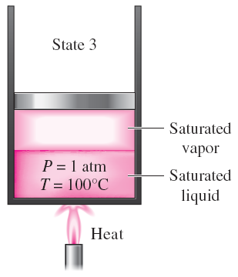
Saturated vapor: A vapor that is about to condense.
Saturated liquid–vapor mixture: The state at which the liquid and vapor phases coexist in equilibrium.
Superheated vapor: A vapor that is not about to condense (i.e., not a saturated vapor).
At 1 atm pressure, the temperature remains constant at 100°C until the last drop of liquid is vaporized (saturated vapor).
As more heat is transferred, the temperature of the vapor starts to rise (superheated vapor).
As more heat is transferred, part of the saturated liquid vaporizes (saturated liquid–vapor mixture).

Slide 10
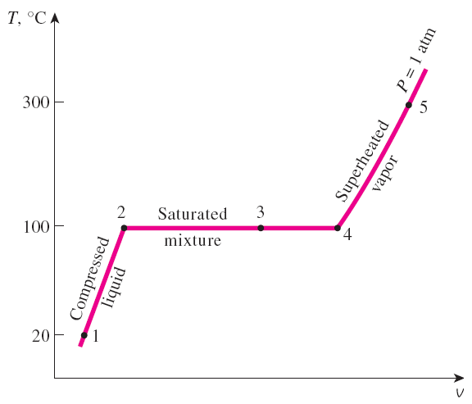
If the entire process between state 1 and 5 described in the figure is reversed by cooling the water while maintaining the pressure at the same value, the water will go back to state 1, retracing the same path, and in so doing, the amount of heat released will exactly match the amount of heat added during the heating process.
T-v diagram for the heating process of water at constant pressure.

Slide 11
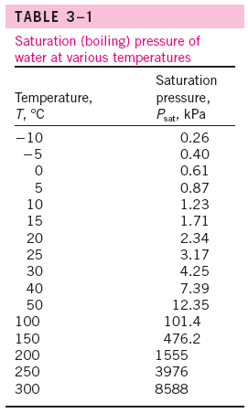
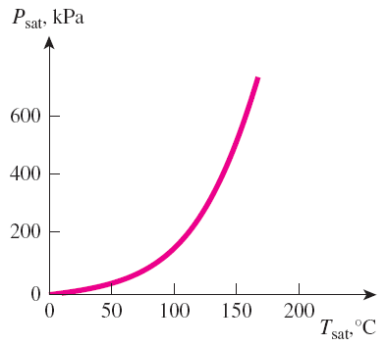
Saturation Temperature and Saturation Pressure
The temperature at which water starts boiling depends on the pressure; therefore, if the pressure is fixed, so is the boiling temperature.
Water boils at 100°C at 1 atm pressure.
Saturation temperature T_{sat}: The temperature at which a pure substance changes phase at a given pressure.
Saturation pressure P_{sat}: The pressure at which a pure substance changes phase at a given temperature.
The liquid–vapor saturation curve of a pure substance (numerical values are for water).

Slide 12
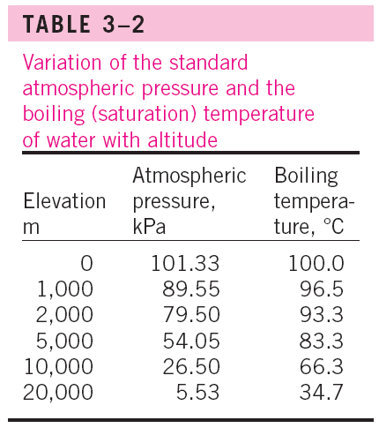
Latent heat: The amount of energy absorbed or released during a phase-change process.
Latent heat of fusion: The amount of energy absorbed during melting. It is equivalent to the amount of energy released during freezing.
Latent heat of vaporization: The amount of energy absorbed during vaporization and it is equivalent to the energy released during condensation.
The magnitudes of the latent heats depend on the temperature or pressure at which the phase change occurs.
At 1 atm pressure, the latent heat of fusion of water is 333.7 kJ/kg and the latent heat of vaporization is 2256.5 kJ/kg.
The atmospheric pressure, and thus the boiling temperature of water, decreases with elevation.

Slide 13
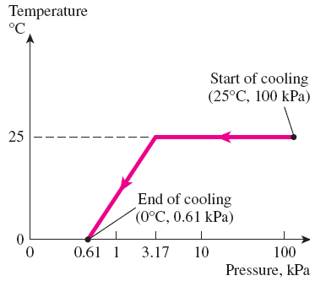
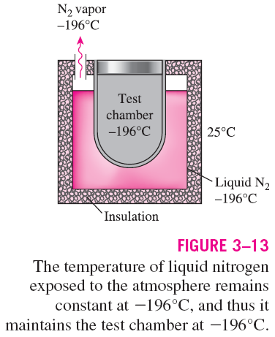
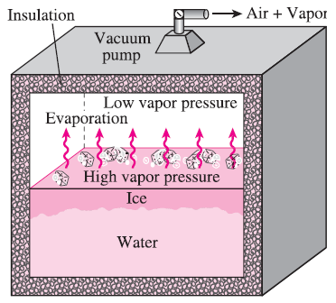
Some Consequences of T_{sat} and P_{sat} Dependence
The variation of the temperature of fruits and vegetables with pressure during vacuum cooling from 25°C to 0°C.
In 1775, ice was made by evacuating the air space in a water tank.

Slide 14
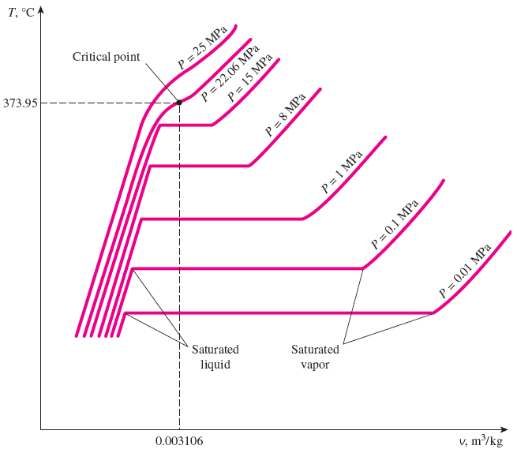
PROPERTY DIAGRAMS FOR PHASE-CHANGE PROCESSES
The variations of properties during phase-change processes are best studied and understood with the help of property diagrams such as the T-v, P-v, and P-T diagrams for pure substances.
T-v diagram of constant-pressure phase-change processes of a pure substance at various pressures (numerical values are for water).

Slide 15
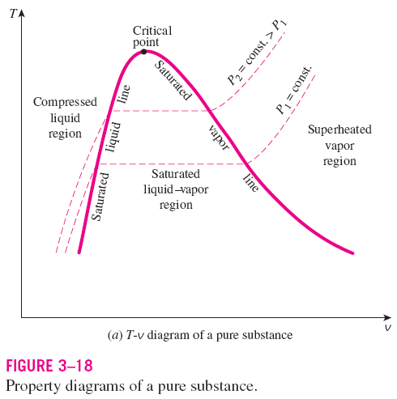
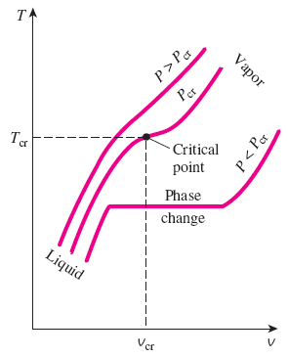
saturated liquid line
saturated vapor line
compressed liquid region
superheated vapor region
saturated liquid–vapor mixture region (wet region)
At supercritical pressures (P > P_{cr}), there is no distinct phase-change (boiling) process.
Critical point: The point at which the saturated liquid and saturated vapor states are identical.

Slide 16
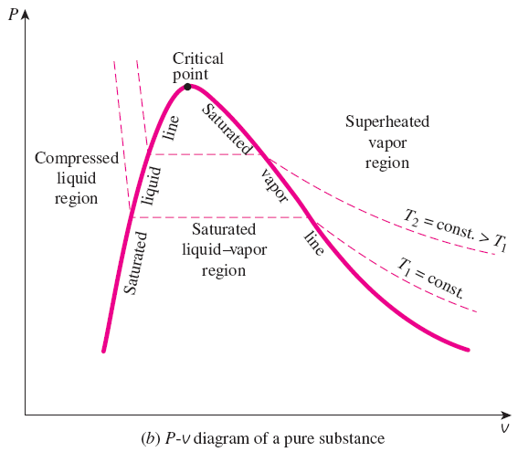
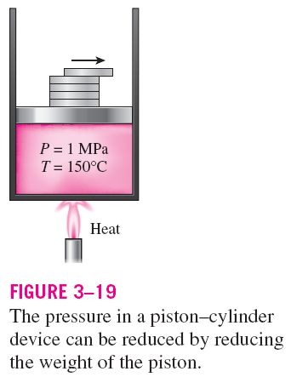

Slide 17
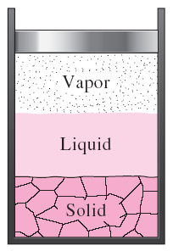
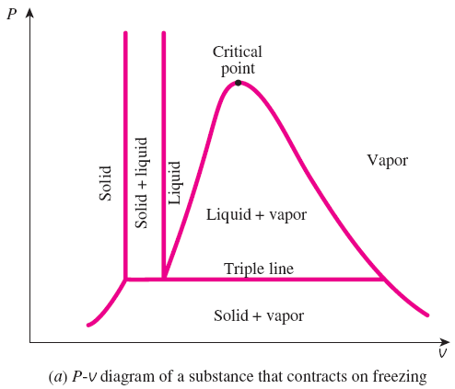
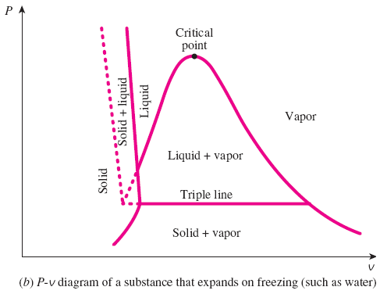
Extending the Diagrams to Include the Solid Phase
For water,
T_{tp} = 0.01°C
P_{tp} = 0.6117 kPa
At triple-point pressure and temperature, a substance exists in three phases in equilibrium.

Slide 18
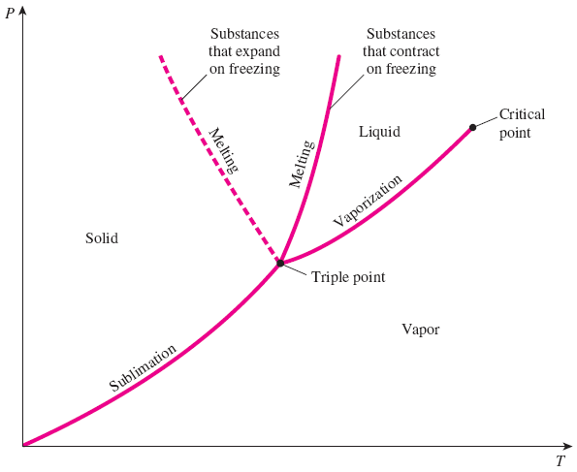
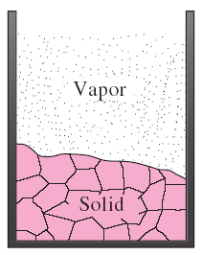
Sublimation: Passing from the solid phase directly into the vapor phase.
Phase Diagram
At low pressures (below the triple-point value), solids evaporate without melting first (sublimation).
P-T diagram of pure substances.

Slide 19
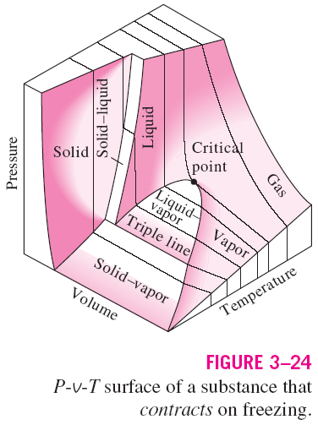
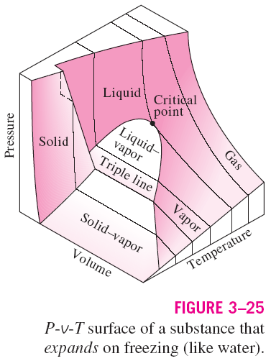
The P-v-T surfaces present a great deal of information at once, but in a thermodynamic analysis it is more convenient to work with two-dimensional diagrams, such as the P-v and T-v diagrams.

Slide 20
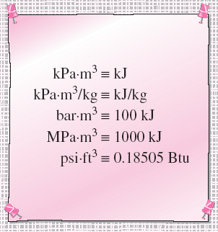


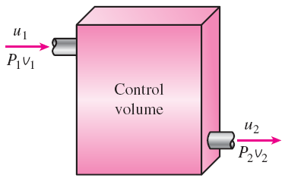
PROPERTY TABLES
For most substances, the relationships among thermodynamic properties are too complex to be expressed by simple equations.
Therefore, properties are frequently presented in the form of tables.
Some thermodynamic properties can be measured easily, but others cannot and are calculated by using the relations between them and measurable properties.
The results of these measurements and calculations are presented in tables in a convenient format.
Enthalpy—A Combination Property
The combination u + Pv is frequently encountered in the analysis of control volumes.
The product pressure × volume has energy units.

Slide 21
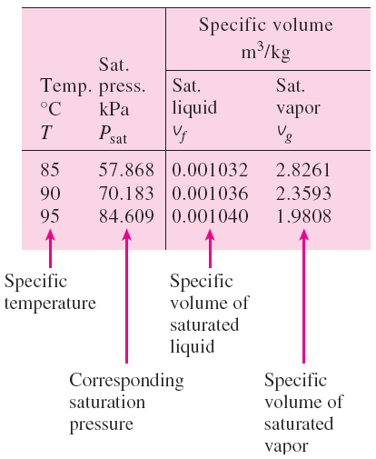
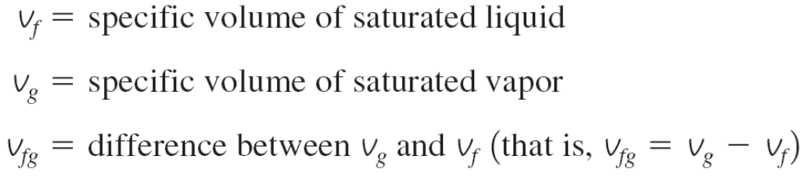
Saturated Liquid and Saturated Vapor States
Table A–4: Saturation properties of water under temperature.
Table A–5: Saturation properties of water under pressure.
A partial list of Table A–4.
Enthalpy of vaporization, h_{fg} (Latent heat of vaporization): The amount of energy needed to vaporize a unit mass of saturated liquid at a given temperature or pressure.

Slide 22
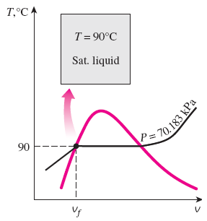
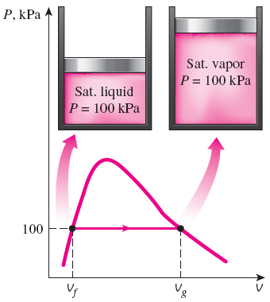
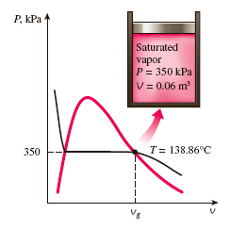
Examples: Saturated liquid and saturated vapor states of water on T-v and P-v diagrams.

Slide 23
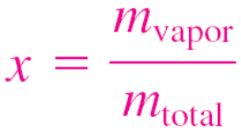
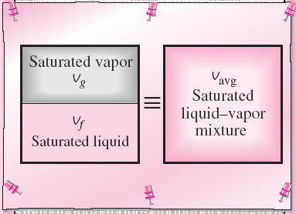
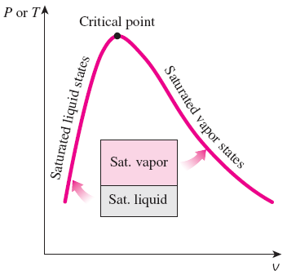
Saturated Liquid–Vapor Mixture
Quality, x : The ratio of the mass of vapor to the total mass of the mixture. Quality is between 0 and 1 0: sat. liquid, 1: sat. vapor.
The properties of the saturated liquid are the same whether it exists alone or in a mixture with saturated vapor.
Temperature and pressure are dependent properties for a mixture.
The relative amounts of liquid and vapor phases in a saturated mixture are specified by the quality x.
A two-phase system can be treated as a homogeneous mixture for convenience.

Slide 24


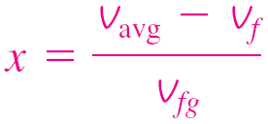


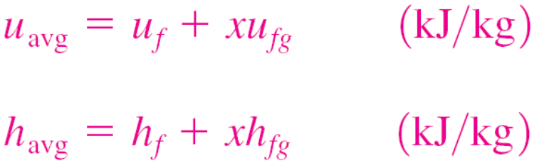
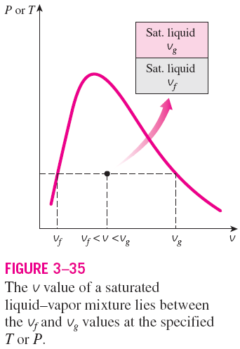
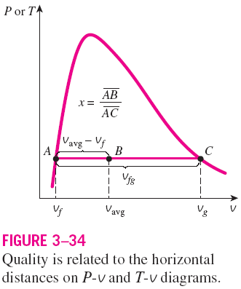
y v, u, or h.

Slide 25
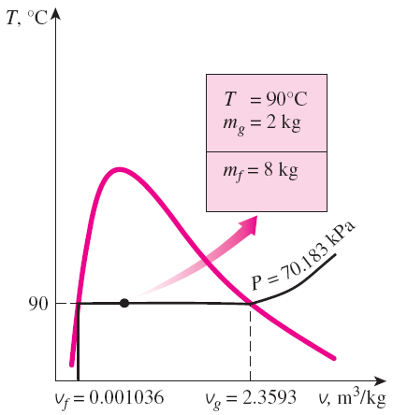
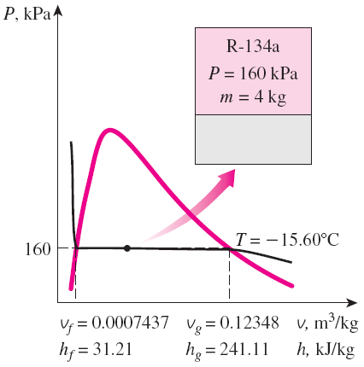
Examples: Saturated liquid-vapor mixture states on T-v and P-v diagrams.

Slide 26



Superheated Vapor
In the region to the right of the saturated vapor line and at temperatures above the critical point temperature, a substance exists as superheated vapor.
In this region, temperature and pressure are independent properties.
Compared to saturated vapor, superheated vapor is characterized by
At a specified P, superheated vapor exists at a higher h than the saturated vapor.
A partial listing of Table A–6.

Slide 27




Compressed Liquid
The compressed liquid properties depend on temperature much more strongly than they do on pressure.
Compressed liquid is characterized by
y → v, u, or h
A more accurate relation for h
A compressed liquid may be approximated as a saturated liquid at the given temperature.

Slide 28


Slide 29


Slide 30


Slide 31


Slide 32


Slide 33



Slide 34

Saturated Steam Table
h_{fg} (kJ/kg)
p (Mpa)
h_{g} (kJ/Kg)
h_{f} (kJ/kg)
h_{g}(p=0.5 Mpa) = 2746.4 + (2758.1-2746.4)/(0.6178-0.4758)*(0.5-0.4758)
=2748.4 kJ/kg for 100% quality saturated vapor
Example: If the quality is 50% and the temperature is 150° C
h_{f} = 632.2, h_{fg} = 2114.2, h_{g} = 2746.4
h = (1-x) h_{f} + x h_{g} = (1-0.5)(632.2) + 0.5(2746.4)
= 1689.3 (kJ/kg)

Slide 35


Linear Interpolation:
Between values in the tables
Subscripts:
L – Value in table at lower end
H – Value in table at upper end
None – value of interest

Slide 36

Superheated Steam
h(p=1MPa, T=350°C)=3157.7 kJ/kg
h(p=1.5MPa, T=350°C)=3147.4 kJ/kg
h(p=1.4MPa, T=350°C)=3157.7+(3147.7-3157.7)*(0.4/0.5)
=3149.7 (kJ/kg)

Slide 37


Reference State and Reference Values
The values of u, h, and s cannot be measured directly, and they are calculated from measurable properties using the relations between properties.
However, those relations give the changes in properties, not the values of properties at specified states.
Therefore, we need to choose a convenient reference state and assign a value of zero for a convenient property or properties at that state.
The reference state for water is 0.01°C and for R-134a is -40°C in tables.
Some properties may have negative values as a result of the reference state chosen.
Sometimes different tables list different values for some properties at the same state as a result of using a different reference state.
However, In thermodynamics we are concerned with the changes in properties, and the reference state chosen is of no consequence in calculations.

Slide 38





THE IDEAL-GAS EQUATION OF STATE
Equation of state: Any equation that relates the pressure, temperature, and specific volume of a substance.
The simplest and best-known equation of state for substances in the gas phase is the ideal-gas equation of state. This equation predicts the P-v-T behavior of a gas quite accurately within some properly selected region.
Ideal gas equation of state
R: gas constant
M: molar mass (kg/kmol)
R_{u}: universal gas constant
Different substances have different gas constants.

Slide 39





Mass = Molar mass × Mole number
Ideal gas equation at two states for a fixed mass
Various expressions of ideal gas equation
Real gases behave as an ideal gas at low densities (i.e., low pressure, high temperature).
Properties per unit mole are denoted with a bar on the top.

Slide 40

Is Water Vapor an Ideal Gas?
At pressures below 10 kPa, water vapor can be treated as an ideal gas, regardless of its temperature, with negligible error (less than 0.1 percent).
At higher pressures, however, the ideal gas assumption yields unacceptable errors, particularly in the vicinity of the critical point and the saturated vapor line.
In air-conditioning applications, the water vapor in the air can be treated as an ideal gas. Why?
In steam power plant applications, however, the pressures involved are usually very high; therefore, ideal-gas relations should not be used.
Percentage of error ([|v_{table} - v_{ideal}|/v_{table}] ×100) involved in assuming steam to be an ideal gas, and the region where steam can be treated as an ideal gas with less than 1 percent error.

Slide 41





COMPRESSIBILITY FACTOR—A MEASURE
OF DEVIATION FROM IDEAL-GAS BEHAVIOR
Compressibility factor Z A factor that accounts for the deviation of real gases from ideal-gas behavior at a given temperature and pressure.
The farther away Z is from unity, the more the gas deviates from ideal-gas behavior.
Gases behave as an ideal gas at low densities (i.e., low pressure, high temperature).
Question: What is the criteria for low pressure and high temperature?
Answer: The pressure or temperature of a gas is high or low relative to its critical temperature or pressure.

Slide 42






Reduced pressure
Reduced temperature
Pseudo-reduced specific volume
Z can also be determined from a knowledge of P_{R} and v_{R}.
Comparison of Z factors for various gases.

Slide 43







OTHER EQUATIONS OF STATE
Several equations have been proposed to represent the P-v-T behavior of substances accurately over a larger region with no limitations.
Van der Waals Equation of State
Critical isotherm of a pure substance has an inflection point at the critical state.
This model includes two effects not considered in the ideal-gas model: the intermolecular attraction forces and the volume occupied by the molecules themselves. The accuracy of the van der Waals equation of state is often inadequate.

Slide 44




Beattie-Bridgeman Equation of State
The constants are given in Table 3–4 for various substances. It is known to be reasonably accurate for densities up to about 0.8ρ_{cr}.
Benedict-Webb-Rubin Equation of State
The constants are given in Table 3–4. This equation can handle substances at densities up to about 2.5 ρ_{cr}.
Virial Equation of State
The coefficients a(T), b(T), c(T), and so on, that are functions of temperature alone are called virial coefficients.

Slide 45


Slide 46


Complex equations of state represent the P-v-T behavior of gases more accurately over a wider range.
Percentage of error involved in various equations of state for nitrogen
(% error = [(|v_{table} - v_{equation}|)/v_{table}] ×100).

Slide 47
Summary
Pure substance
Phases of a pure substance
Phase-change processes of pure substances
  Compressed liquid, Saturated liquid, Saturated vapor, Superheated vapor
  Saturation temperature and Saturation pressure
Property diagrams for phase change processes
  The T-v diagram, The P-v diagram, The P-T diagram, The P-v-T surface
Property tables
  Enthalpy
  Saturated liquid, saturated vapor, Saturated liquid vapor mixture, Superheated vapor, compressed liquid
  Reference state and reference values
The ideal gas equation of state
  Is water vapor an ideal gas?
Compressibility factor
Other equations of state
  van der Waals Equation of State, Beattie-Bridgeman Equation of State
  Benedict-Webb-Rubin Equation of State, Virial Equation of State

